Slide 1
Project 2: Hotel Reservation Analysis with SQL
Avishu Panwar MIP-DA-04

Slide 2


Introduction
In this Project, we will use SQL to answer the questions related to the dataset. This will help us develop data analysis skills in a practical context.
Overview
The hotel industry relies on data to make informed decisions and provide a better guest experience. In this project, we will work with a hotel reservation dataset to gain insights into guest preferences, booking trends, and other key factors that impact the hotel's operations. We will use SQL to query and analyze the data, as well as answer speciﬁc questions about the dataset.

Slide 3





Understanding Dataset
Table Name : hotel_reservation_data
Booking_ID: A unique identiﬁer for each hotel reservation. no_of_adults: The number of adults in the reservation. no_of_children: The number of children in the reservation. no_of_weekend_nights: The number of nights in the reservation that fall on weekends.
no_of_week_nights: The number of nights in the reservation that fall on weekdays.
type_of_meal_plan: The meal plan chosen by the guests.
room_type_reserved: The type of room reserved by the guests.
lead_time: The number of days between booking and arrival.
arrival_date: The date of arrival.
market_segment_type: The market segment to which the reservation belongs.
avg_price_per_room: The average price per room in the reservation.
booking_status: The status of the booking.

Slide 4
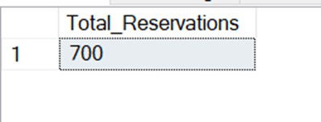
Problem Statement 1
What is the total number of reservations in the dataset?
select count(Booking_ID) as Total_Reservations from hotel_reservation_data

Slide 5
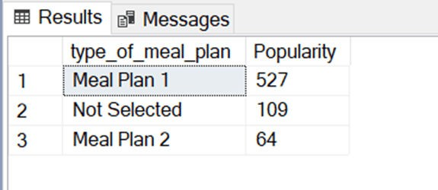
Problem Statement 2
Which meal plan is the most popular among guests?
select type_of_meal_plan,count(type_of_meal_plan) as Popularity from hotel_reservation_data
group by type_of_meal_plan
order by count(type_of_meal_plan) desc
In this query we can use TOP 1 after select keyword to get only the ﬁrst row i.e. the most popular meal plan which is Meal Plan 1 with
527 bookings

Slide 6
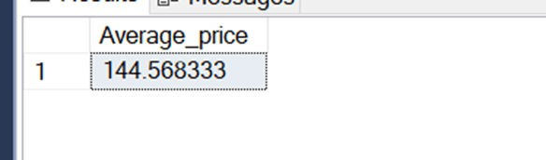
Problem Statement 3
What is the average price per room for reservations involving children?
select avg(cast(avg_price_per_room as decimal(10,2))) as Average_price from hotel_reservation_data
where no_of_children>0

Slide 7
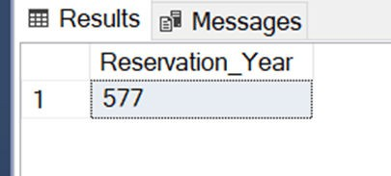
Problem Statement 4
How many reservations were made for the year 20XX (replace XX with the desired year)?
select COUNT(Booking_ID) as Reservation_Year from hotel_reservation_data
where year(arrival_date)=2018

Slide 8
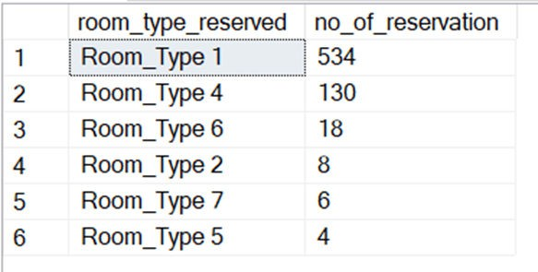
Problem Statement 5
What is the most commonly booked room type?
select room_type_reserved,count(room_type_reserved) as no_of_reservation from hotel_reservation_data
group by room_type_reserved
order by count(room_type_reserved) desc
In this query we can use TOP 1 after select keyword to get only the ﬁrst row i.e. the most commonly booked room type which is Room_Type_1 with 534 reservations

Slide 9
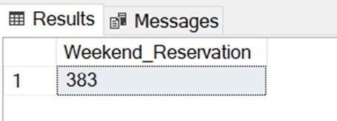
Problem Statement 6
How many reservations fall on a weekend (no_of_weekend_nights > 0)?
select Count(Booking_ID) as Weekend_Reservation from hotel_reservation_data
where no_of_weekend_nights>0

Slide 10
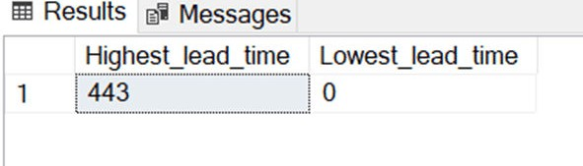
Problem Statement 7
What is the highest and lowest lead time for reservations?
select max(lead_time) as Highest_lead_time , min(lead_time) as Lowest_lead_time
from hotel_reservation_data

Slide 11
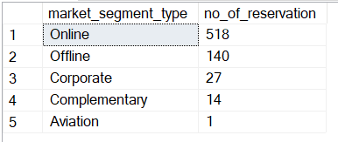
Problem Statement 8
What is the most common market segment type for reservations?
select market_segment_type,count(market_segment_type) as no_of_reservation
from hotel_reservation_data group by market_segment_type
order by count(market_segment_type) desc
In this query we can use TOP 1 after select keyword to get only the ﬁrst row i.e. the most common market segment which is Online market with 518 reservations

Slide 12
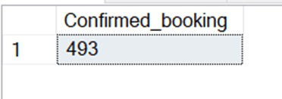
Problem Statement 9
How many reservations have a booking status of "Conﬁrmed"?
select count(Booking_ID) as Conﬁrmed_booking from hotel_reservation_data
where booking_status='Not_Canceled'

Slide 13
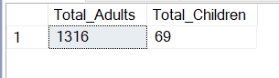
Problem Statement 10
What is the total number of adults and children across all reservations?
select sum(no_of_adults) as Total_Adults, sum(no_of_children) as Total_Children
from hotel_reservation_data

Slide 14
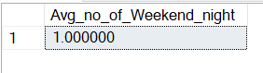
Problem Statement 11
What is the average number of weekend nights for reservations involving children?
select avg(cast(no_of_weekend_nights as decimal(10,2))) as Avg_no_of_Weekend_night
from hotel_reservation_data where no_of_children>0

Slide 15
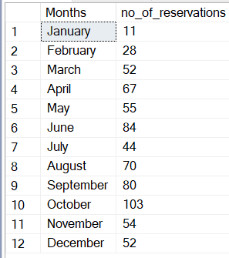
Problem Statement 12
How many reservations were made in each month of the year?
select datename(month,arrival_date) as Months , count(datename(month,arrival_date)) as no_of_reservations
from hotel_reservation_data
group by datename(month,arrival_date),DATEPART(mm, arrival_date) order by DATEPART(mm, arrival_date)

Slide 16
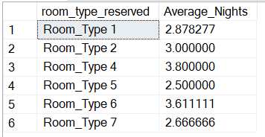
Problem Statement 13
What is the average number of nights (both weekend and weekday) spent by guests for each room type?
select room_type_reserved,
avg(cast(no_of_week_nights+no_of_weekend_nights as decimal(10,2))) as Average_Nights
from hotel_reservation_data
group by room_type_reserved

Slide 17
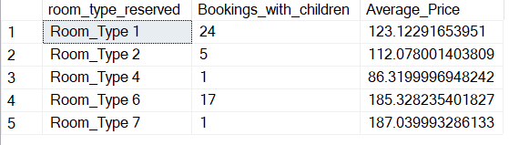
Problem Statement 14
For reservations involving children, what is the most common room type, and what is the average price for that room type?
select room_type_reserved,count(Booking_ID) as Bookings_with_children, avg(avg_price_per_room)as Average_Price
from hotel_reservation_data where no_of_children>0 group by room_type_reserved
In this query we can use TOP 1 after select keyword to get only the ﬁrst row i.e. the most common room involving children which is Room_Type_1 with Average
Price of 123.12 with 24
has
bookings which children

Slide 18
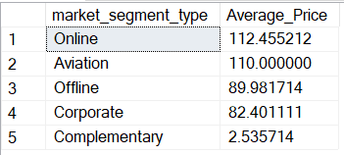
Problem Statement 15
Find the market segment type that generates the highest average price per room.
select market_segment_type,avg(cast(avg_price_per_room as decimal(10,2))) as Average_Price
from hotel_reservation_data group by market_segment_type
order by avg(avg_price_per_room) desc
In this query we can use TOP 1 after select keyword to get only the ﬁrst row
i.e. the market segment that generates the highest Average price which is
Online market with an Average price of 112.455

Slide 19
Thanks!

